Slide 1



Slide 2




TEAM-06
Manohar Venkat Seeram
Team Leader
Data Acquisition
Model Development
Guduru Sri Vidhya
Story Telling
Data Visualization
Satish Nepal
Data Preprocessing
Report Development
Madisetty Venkata Sai Rakesh
Model Deployment
Data Visualization

Slide 3
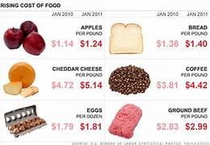
TABLE OF CONTENTS
Abstract
Dataset
Challenges
Methodologies & Tools
Proposed Solution

Slide 4
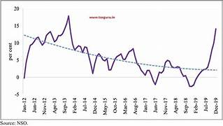
ABSTRACT
Food price inflation is an important metric to inform economic policy but traditional sources of consumer prices are too often produced with delay during crisis and only at an aggregate level. This may poorly reflect the actual price trends in rural or poverty-striken areas where large populations reside in fragile situation.

Slide 5
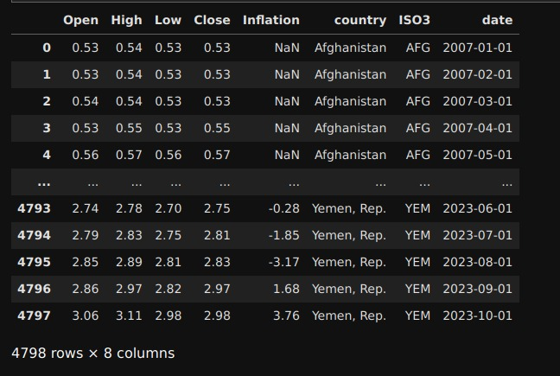
DATASET
Monthly Food Price Inflation dataset is taken from Kaggle.
The following challenges were extracted based on this dataset and this project provides valuable insights for decision –makers.

Slide 6
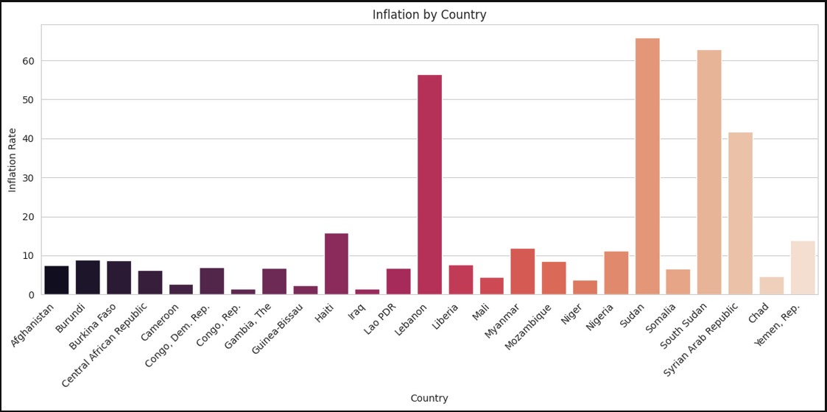

Slide 7
CHALLENGES
CHALLENGES
Labour Cost
Supply Chain Disruption
Market Competition

Slide 8
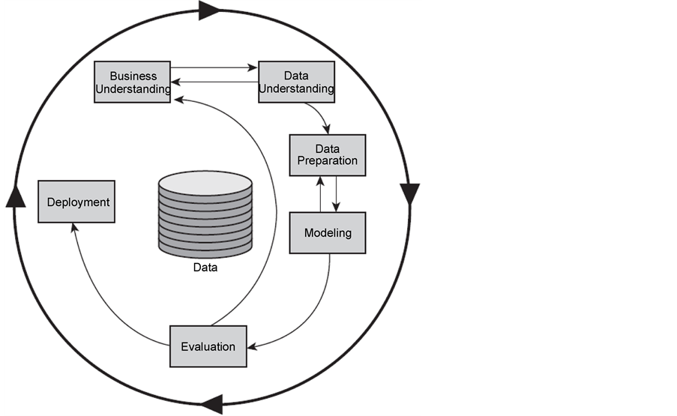
CRISP-DM:
For planning and executing data mining and data analytics initiatives, several organizations adopt the Cross-Industry Standard Process for Data Mining (CRISP-DM). Although CRISP-DM is frequently used for activities like predictive modeling and data analysis, it may also be customized to address issues like calculating and predicting the monthly inflation in food prices.

Slide 9
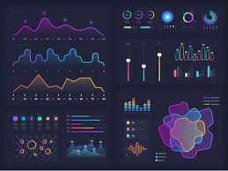
METHODOLOGIES & TOOLS
Data Analysis and Visualization :
Proper data preparation and understanding is essential before beginning analysis or creating visualizations.
Tools:
Matplotlib, Seaborn.

Slide 10
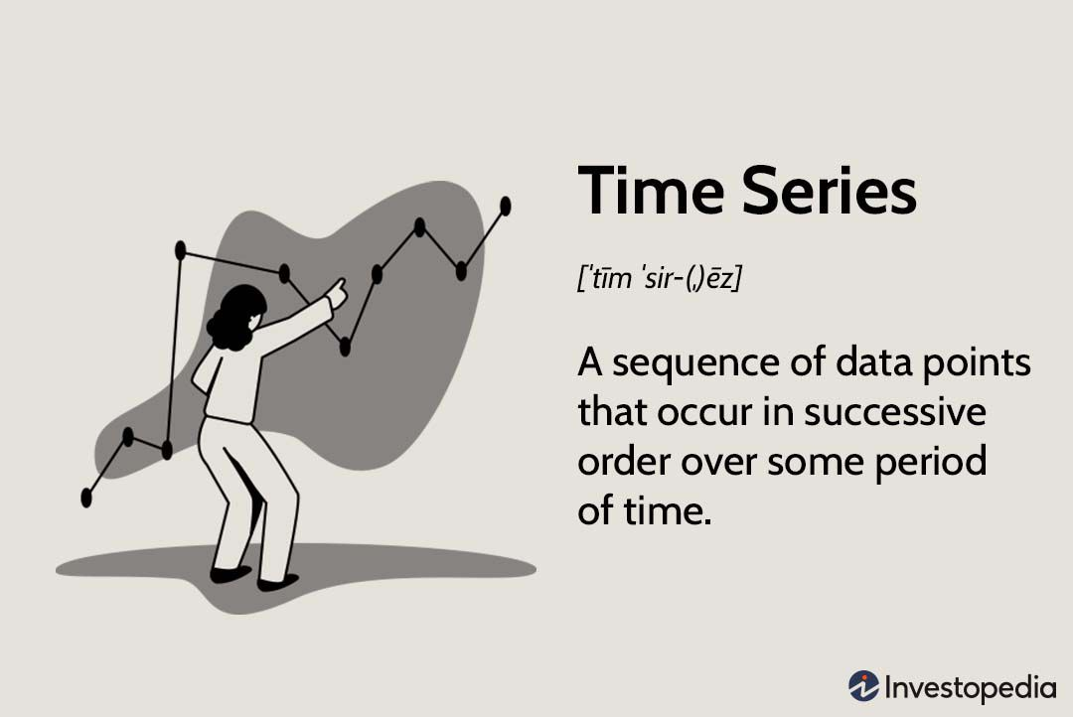
Time series Analysis:
Proper time series analysis starts by checking and preparing the data, including testing for stationarity and decomposing the series into trend, seasonal, and residual components. Appropriate training and test set selection is important to avoid look-ahead bias.
Tools:
Statsmodels.

Slide 11

Regression analysis:
Regression analysis models the relationship between a dependent variable and one or more independent variables.
Tools:
Sci-kit learn, TensorFlow.

Slide 12
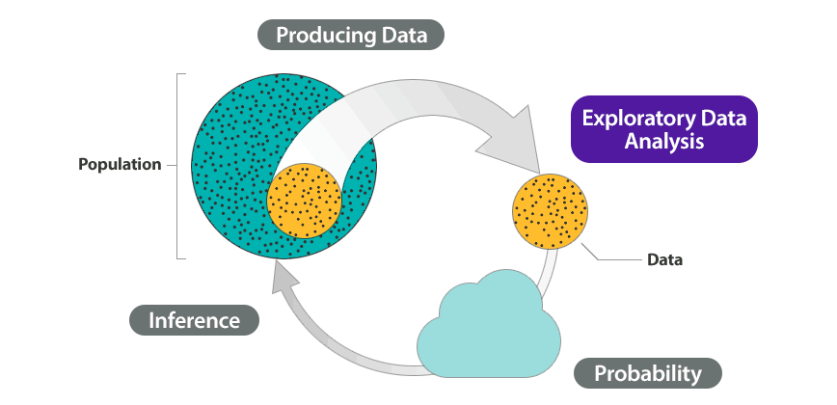
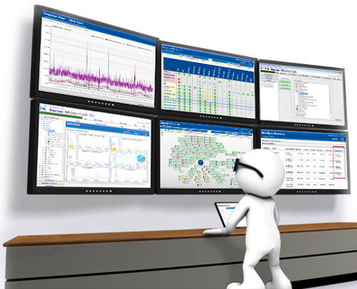
PROPOSED SOLUTION
Data analysis and forecasting:
Data science requires predictions and data analysis to function. They involve analyzing past data in order to gain insights and forecast future patterns.
Continuous monitoring and updating:
Set up a system for continuous monitoring of relevant data and models. Regularly update your models to adapt to changing conditions and improve predictive accuracy.

Slide 13
